Slide 1


Training IT test
http://schoolacademy.telerik.com
Test for IT Olympiad
William Shakespeare
Telerik group project

Slide 2
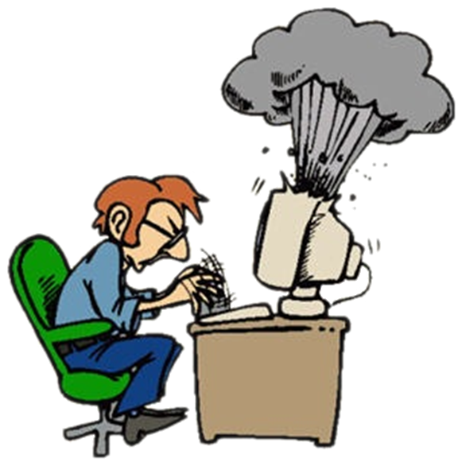

Computer systems
Hardware

Slide 3
Question
What are some of the main components of a modern video card?
Video BIOS, CPU, Video memory
SSD, Video memory, GPU
RAMDAC, UPS, Heat Sink
GPU, Video BIOS, RAMDAC

Slide 4
Answer
Information:
http://en.wikipedia.org/wiki/Video_card

Slide 5



Computer programs
Software

Slide 6
Question
Which are some of the stages of the Software release life cycle?
Alpha, Beta, Gamma
Pre-alpha, Gamma, Release candidate
Pre-beta, Alpha, General availability
Alpha, Beta, General availability

Slide 7
Answer
Information:
http://en.wikipedia.org/wiki/Software_release_life_cycle

Slide 8



Rules for working with and supporting computer systems
Installation, usage, support…

Slide 9
Question
If you have a full HD monitor connected with the laptop with video card that supports HD via VGA cable and the laptop max screen resolution is 1366 : 768, what will be the monitor’s resolution if you extend the displays ?
It will still be with a full HD resolution.
You can’t connect laptop and monitor with VGA cable
It will be with HD ready resolution
Both screens will be with a full HD resolution

Slide 10
Answer
Information:
http://en.wikipedia.org/wiki/VGA_connector
http://en.wikipedia.org/wiki/Multi-monitor

Slide 11

Means of data transfer in IT, Numeral systems
Data transfer, units for measurement, numeral systems

Slide 12
Question
Which of the following is a communication protocol?
TCP
OpenGL
ISO/IEC
SQL

Slide 13
Answer
The Transmission Control Protocol (TCP) is one of the core protocols of the Internet protocol suite (IP), and is so common that the entire suite is often called TCP/IP. TCP provides reliable, ordered, error-checked delivery of a stream of octets between programs running on computers connected to a local area network, intranet or the public Internet.
Information:
http://en.wikipedia.org/wiki/Transmission_Control_Protocol

Slide 14





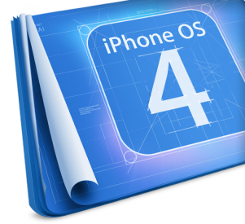









Operating systems
Architecture, processes, users, user interface, file systems

Slide 15
Question
Which OS functionality is NOT kernel's responsibility:
Memory allocation and management
Resources' scheduling
Graphical User Interface management
Communication with the device drivers
CPU interrupts management

Slide 16
Answer
The OS shell provides a user interface for access to an OS's kernel services. The GUI (Graphical User Interface) and CLI (Command Line Interface) are part of the OS shell.
Some of the kernel's main responsibilities are memory management, device management and handling system calls. Information:
http://en.wikipedia.org/wiki/Shell_(computing)
http://en.wikipedia.org/wiki/Kernel_(computer_science)

Slide 17

Software engineering and project development
Analysis, specification, designing, prototype, implementation, testing, support, …

Slide 18
Question
Which recommendation is NOT a rule of Extreme Programming (XP):
Make frequent small releases
Move people around domains so that no knowledge is privilege of only one person
All production code should be pair programmed
Plan and implement in advance functionality that might be needed in the future

Slide 19
Answer
When doing the system design, keep it uncluttered with extra stuff you guess will be used later. Only 10% of that extra stuff will ever get used, so you are wasting 90% of your time. Keeping your code ready for unexpected changes is about simple design. Adding extra flexibility beyond what you need now always makes a design more complex.
Information:
http://www.extremeprogramming.org/rules.html

Slide 20




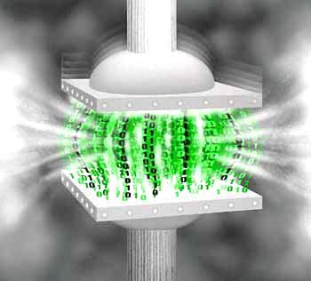




Compressing and decompressing data
Algorithm for compression, archivation software

Slide 21
Question
Which one is true about Run - length encoding?
misses not important details
avoid repetition of same elements
round not important bits
cuts the end of the file

Slide 22
Answer
Information:
http://en.wikipedia.org/wiki/Data_compression

Slide 23



Text processing software
File formats, text, tables, figures, …

Slide 24
Question
Which is true about Google Docs
Documents, spreadsheets, presentations can be created with Google Docs;
Documents, spreadsheets, presentations can be imported through the web interface or sent via email
Google Docs always highlights changes, made by a particular editor in real time during a writing session;
a) and b) are correct;
a) and c) are correct;
All of the above are correct.

Slide 25
Answer
Google Docs is Google's "software as a service" office suite. Documents, spreadsheets, presentations can be created with Google Docs, imported through the web interface, or sent via email. There is no way to highlight changes made by a particular editor in real time during a writing session, nor a way to jump to the changes made.
Information:
http://en.wikipedia.org/wiki/Google_Docs

Slide 26
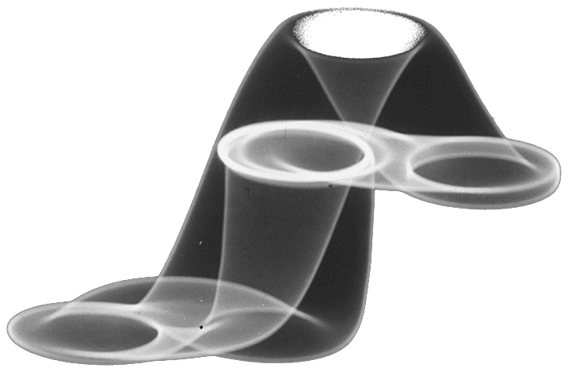



Computer graphics
Raster and vector graphics, graphical file formats, graphical redactors, color codes

Slide 27
Question
Anaglyph 3D is?
Stereoscopic 3D effect using filters of different colors.
A collection of vertices, edges and faces that defines the shape of a polyhedral object in 3D computer graphics
Effect that causes different signals to become indistinguishable
Method of enhancing the image quality of textures.

Slide 28
Answer
Anaglyph 3D is the name given to the stereoscopic 3D effect achieved by means of encoding each eye's image using filters of different (usually chromatically opposite) colors, typically red and cyan. Anaglyph 3D images contain two differently filtered colored images, one for each eye. When viewed through the "color-coded" "anaglyph glasses", each of the two images reaches one eye, revealing an integrated stereoscopic image. The visual cortex of the brain fuses this into perception of a three dimensional scene or composition.
Information:
http://en.wikipedia.org/wiki/Google_Docs

Slide 29






Databases
Data models, tables, relations, SQL

Slide 30
Question
Which of the following is NoSQL Database?
MySQL
PostgreSQL
MongoDB
Oracle RDB

Slide 31
Answer
MySQL, PostrgreSQL and Oracle RDB are relational databases. MongoDB is classified as a "NoSQL" database, it eschews the traditional table-based relational database structure in favor of JSON-like documents with dynamic schemas.
Information:
http://en.wikipedia.org/wiki/MongoDB

Slide 32

Information systems
ERP, CRM, BI, BPM, FMIS, CAD/CAM, CMS

Slide 33
Question
What are the components of an Information System?
Hardware, Software, Data, Procedures and Personnel
Hardware, Software, Data and Procedures
Hardware, Software and Data
Hardware, Data, Procedures, Personnel;
Software, Data, Procedures and Personnel.

Slide 34
Answer
Hardware are the input and output devices constitute the hardware components of IS Software are the programs and applications that convert data into machine-readable language Procedures are sets of rules or guidelines, which an organization establishes for the use of a computer-based information system Personnel are the computer experts, programmers, etc.
Information:
http://en.wikipedia.org/wiki/Information_systems#Components

Slide 35


Security
Symmetrical and asymmetrical coding algorithms, electronic signature, digital certificates

Slide 36
Question
Which cryptographic algorithm is based on the product of two large prime numbers:
DES
RSA
SHA-1
MD5

Slide 37
Отговор
RSA is asymmetric method for encoding. A user of RSA creates and then publishes the product of two large prime numbers as their public key. Anyone can use the public key to encrypt a message. If the public key is large enough, only someone with knowledge of the prime factors can feasibly decode the message.
Information:
http://en.wikipedia.org/wiki/RSA_(algorithm)

Slide 38




Presentation making & Presentation skills
Software for presentations, presentation making, slides, effects, notes, colors, images, audio, video

Slide 39
Question
What is the average attention span for people watching a presentation?
One to three minutes
Maximum twenty minutes
About half an hour
More than half an hour

Slide 40
Answer
Common estimates for sustained attention to a freely chosen task range from about five minutes for a two-year-old child to a maximum of around 20 minutes in older children and adults.
Information:
http://en.wikipedia.org/wiki/Attention_span

Slide 41
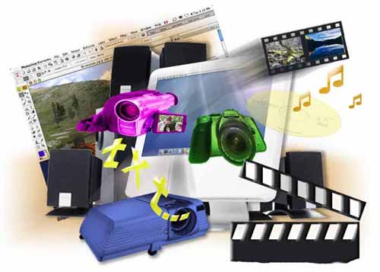



Multimedia
Software for creating and editing multimedia: audio, video, file formats

Slide 42
Question
Which of the following audio codecs is without compression?
APE
AAC
WAV
FLAC
ALAC
MPEG-4

Slide 43
Answer
It is the main format used on Windows systems for uncompressed audio.
Also known with abbreviation of “.wave”
The WAV files are large but suitable for retaining high quality audio.
Information:
http://en.wikipedia.org/wiki/WAV
http://en.wikipedia.org/wiki/List_of_codecs

Slide 44


Computer networks
OSI model, network models, protocols, standards, hardware equipment

Slide 45
Question
What does the name of the network protocol UDP stand for?
Unidirectional Data Protocol
Unreliable Data Protocol
User Datagram Protocol
Universal Data Protocol
Unidirectional Datagram Protocol

Slide 46
Answer
The "User Datagram Protocol" (UDP) is one of the core members of the protocols used for data transfer in Internet, which is characterized with its speed. UDP is minimal transfer protocol, which computer applications can use to send messages, in this case referred to as "datagrams". UDP does not guarantee data delivery, order of delivery or duplicate protection, but provides checksums for data integrity and port numbers for addressing different functions at the source and destination of the datagram.
Information:
http://en.wikipedia.org/wiki/User_Datagram_Protocol

Slide 47
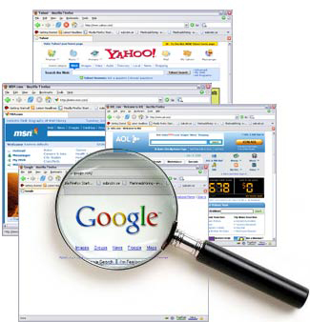


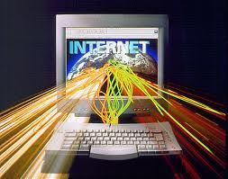
Internet
Internet, protocols, services, WWW, HTTP, FTP, SMTP, POP3, IMAP, WebDAV, IP, DNS, …

Slide 48
Question
Which one of the protocols IMAP, POP3 and SMTP provides the sending of email messages in mail clients (Outlook, Thunderbird etc.)?
IMAP
POP3
SMTP
All of the above protocols can download and send email messages in mail clients.

Slide 49
Answer
All three protocols IMAP, POP3 and SMTP are used in mail clients for message exchange. IMAP and POP3 are used for downloading messages and SMTP is used to send messages.
Information:
http://en.wikipedia.org/wiki/Simple_Mail_Transfer_Protocol

Slide 50




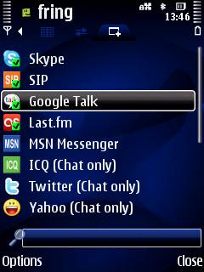
Electronic communication and e-mail
E-mail, Skype, ICQ, IRC, MSN Messenger, Yahoo Messenger, social networks, forums, …

Slide 51
Question
What are the components that the Internet e-mail message consists of?
envelope and body
header and body
all of the above
none of the above

Slide 52
Answer
The internet e-mail message consists of message envelope, message header and message body.
Information:
http://en.wikipedia.org/wiki/Email

Slide 53




World Wide Web (WWW)
How does WWW work? Protocols HTTP, GET, POST, URL, web browser, web page, website…

Slide 54
Question
Which is the first graphical web browser?
Netscape Navigator
Internet Explorer
WorldWideWeb
Mosaic

Slide 55
Answer
The first web browser was invented in 1990 by Sir Tim Berners-Lee. It was called WorldWideWeb and was later renamed Nexus.
Information:
http://en.wikipedia.org/wiki/Web_browser

Slide 56




Web design, HTML, CSS
Web design, HTML, CSS, text, graphics, tables, forms, …

Slide 57
Question
What is LESS?
Design pattern
Dynamic Stylesheet Language
JavaScript open source IDE
Modeling language

Slide 58
Answer
LESS (Leaner CSS) is a dynamic stylesheet language designed by Alexis Sellier. LESS extends CSS with dynamic behavior such as variables, mixins, operations and functions.
Information:
http://en.wikipedia.org/wiki/LESS_(stylesheet_language)
http://lesscss.org/

Slide 59





JavaScript
Developing scripts with JavaScript, basic JavaScript constructions, operators, objects, manipulating the DOM tree

Slide 60
Question
Which of the following is not an object oriented programming language?
C#
C++
PHP
Bash
Java
Python

Slide 61
Answer
Bash is a scripting language
Information:
http://en.wikipedia.org/wiki/Bash_(Unix_shell)

Slide 62
Team William Shakespeare
Tsvetomir Shavely
Lilia Kostova
Lubomir Dimitrov
Yana Yankova
Martin Hristov
Nikolay Tsonev
Mihail Vakov
Dimitar Kostov
Mladen Mladenov
Georgi Ilkov
Radko Ivanov

